Slide 1
Secure data hiding in image using steganography
CAPSTONE PROJECT
Presented By: Vipul S. Matkar
Student Name : Vipul Sahadev Matkar
College Name & Department : A.C. Patil College Of Engineering /
Computer Science Engineering (IOT & Cyber Security Including Blockchain Technology)

Slide 2
OUTLINE
Problem Statement
Technology used
Wow factor
End users
Result
Conclusion
Git-hub Link
Future scope

Slide 3
Problem Statement
In the digital era, secure communication is crucial to protect sensitive information from cyber threats. Traditional encryption methods attract attention, making them vulnerable to attacks. Steganography offers a solution by hiding information within digital media (images, audio, video, or text) in a way that remains undetectable.

Slide 4
Technology used
Mention libraries:- OpenCV
Platforms:- VS Code

Slide 5
Wow factors
Invisible Communication – Unlike encryption, steganography keeps the existence of the message itself a secret.
Undetectable Data Transfer – Can be used in watermarking, secret messaging, and digital rights management.
Combination with Cryptography – Double security when combined with encryption techniques.

Slide 6
End users
Government & Military – Secure covert communication and intelligence transmission.
Journalists & Whistleblowers – Safe transmission of sensitive information without detection.
Forensics & Cybersecurity – Used in digital watermarking to track document authenticity.
Corporate Sector – Protects confidential business information from industrial espionage.

Slide 7
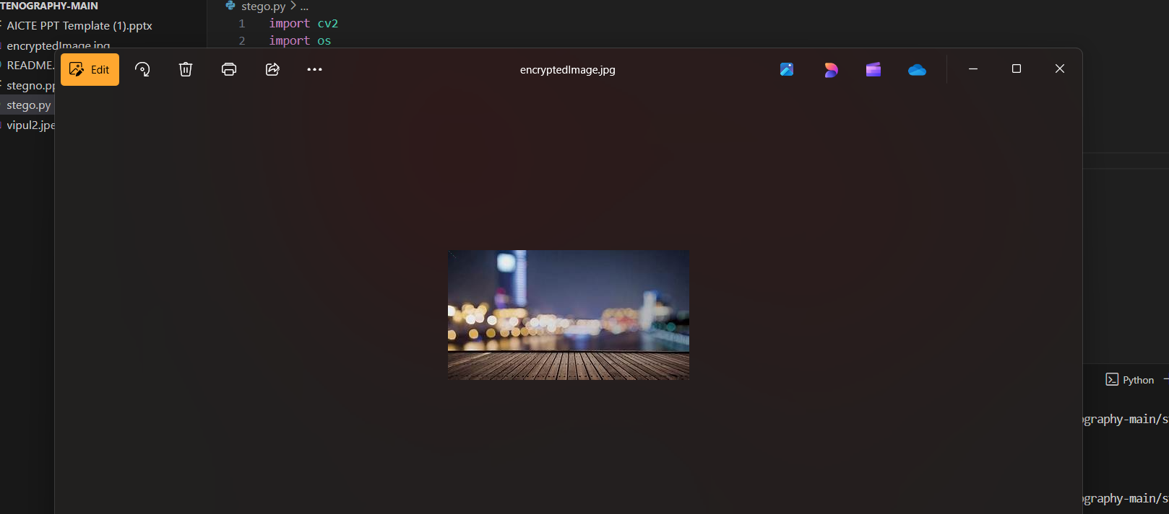
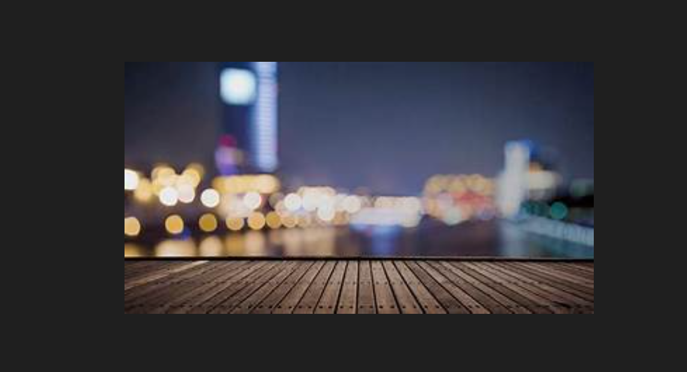

Results
Figure 1.1 Main Image
Figure 1.2 Encrypted Image
Figure 1.3 Code & input

Slide 8
Conclusion
Steganography is an effective technique for secure communication, but it must be used responsibly. While it aids in protecting privacy, it can also be misused for illicit activities. Further research is needed to improve steganalysis methods to detect and prevent malicious use.

Slide 9
GitHub Link
https://github.com/vipul37/aicteproject.git

Slide 10
Future scope(optional)
Steganography is an evolving field with vast potential for future applications. Here are some key areas where steganography is expected to advance:
AI and Machine Learning in Steganography
3D and Video Steganography
Blockchain and Steganography
Quantum Steganography

Slide 11
THANK YOU

